Slide 1

STACK
J.Govindarajan, Asst.Prof. (Sr.Gr) , CSE

Slide 2

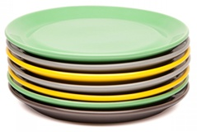
Stack – Real-Time Analogy
Last In First Out (LIFO)

Slide 3
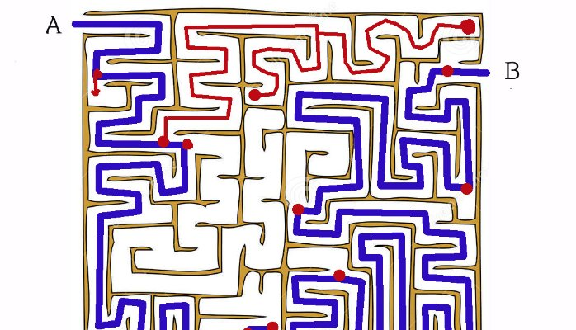
Stack – Real Time Analogy
Maze Game
Backtracking

Slide 4
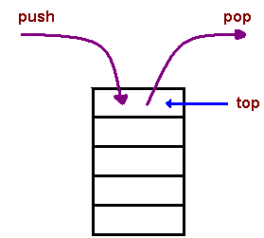
Stack
Last-In-First-Out (LIFO) ADT
Linear Data Structure
Remembers the order in which data was entered

Slide 5
Applications of stack in computer science
Web browsers store the addresses of recently visited websites.
Undo operations of Text editors
Recursion

Slide 6
Stack ADT
Update Methods
- push(e):
Adds element e to the top of the stack.
- pop( ):
Removes and returns the top element from the stack (or null if the stack is empty).

Slide 7
Stack ADT
Accessor Methods
- top( ):
Returns the top element of the stack, without removing it (or null if the stack is empty).
- size( ):
Returns the number of elements in the stack.
- isEmpty( ):
Returns a boolean indicating whether the stack is empty

Slide 8
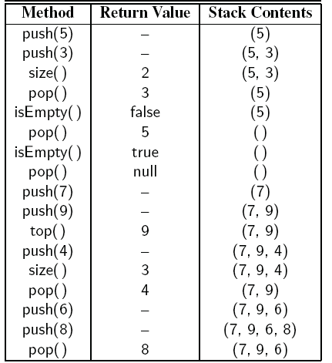
Stack : Example

Slide 9
Stack Operations : Exceptions
Stack is empty
Stack is Full
pop() will throw error
Top
50
Top
push() will throw error
15
40
20

Slide 10
Stack ADT => Stack Interface in Java
public interface Stack<E> {
int size(): //returns number of objects in the stack
boolean isEmpty(); //returns true if stack is empty, false otherwise
E top(); //returns top object in stack, throws exception if stack empty
void push(E element): //inserts object at top of stack
E pop(); //throws (StackEmptyException)
}

Slide 11
Stack ADT Operations : Algorithm Design

Slide 12
Implementing Stack using Array: Logical View vs Physical View (Stack vs Array)
3
2
15
20
40
15
1
40
Top
0
20
0
1
2
3
Top
Logical View (Stack)
Physical View (Array)

Slide 13
Stack ADT: push(e)
Algorithm push(e)
top → top +1
S[top] → e
3
3
50
Top
2
15
Top
15
2
1
40
40
1
0
20
0
20
Algorithm push(e)
if size() < N then
top → top +1
S[top] → e
Before push (50)
After push (50)

Slide 14
Stack ADT: pop()
3
3
Algorithm pop()
e → S[top]
top → top -1
return e
2
15
Top
2
1
40
40
1
Top
0
20
0
20
Before pop()
After pop()
Algorithm pop()
if not(isEmpty()) then
e → S[top]
top → top -1
return e
else
throw StackEmptyException

Slide 15
Stack ADT : size() and isEmpty()
3
Algorithm size()
return top+1
15
2
Top
1
40
0
20
Algorithm isEmpty()
if (top < 0) then
return true
else
return false
3
2
1
0
Top

Slide 16
Stack ADT : top()
3
Algorithm top()
if isEmpty() then
throw StackEmptyException
else
return S[top]
15
2
Top
1
40
0
20

Slide 17
Stack ADT operations : Complexity analysis

Slide 18
Stack ADT: push(e) and pop() time complexity
Algorithm push(e)
if size() < N then
top → top +1
S[top] → e
else
throw StackFullException
Algorithm pop()
if not(isEmpty()) then
e → S[top]
top → top -1
return e
else
throw StackEmptyException
O(1)
O(1)

Slide 19
Stack ADT: size(),isEmpty(),top() time complexities
Algorithm size()
return top+1
Algorithm isEmpty()
if (top < 0) then
return true
else
return false
=> O(1)
=> O(1)
Algorithm top()
if isEmpty() then
throw StackEmptyException
else
return S[top]
=> O(1)

Slide 20
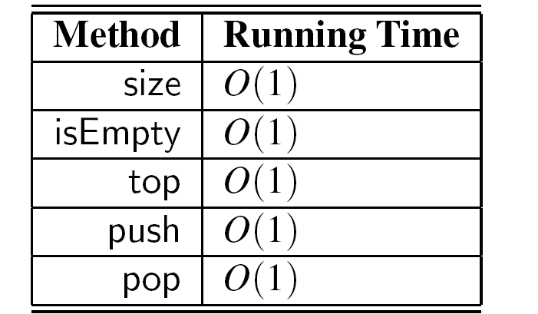
Stack ADT
Space Complexity O(N) => independent of stack size n
where, N is size of array

Slide 21
Stack ADT : Space Complexity
3
O(N)
2
1
0
Top

Slide 22
Stack ADT – Array Implementation : Merits and Demerits
Merits :
- Simple
- Efficient
Demerits :
- Difficulty in specifying size of the stack
> smaller size may cause earlier StackFullException
> larger size may cause memory wastage

Slide 23
Exercise
Reverse the order of elements on stack S using one additional stack

Slide 24
Application: Palindrome Checking
Write an algorithm for Palindrome Checking Using Stack.

Slide 25
Infix to Postfix Conversion
When an operand is read, output it
When an operator is read
– Pop until the top of the stack has an element of lower precedence and then push it
When ) is found, pop until we find the matching ( •
has the lowest precedence when in the stack • but has the highest precedence when in the input
When we reach the end of input, pop until the stack is empty

Slide 26
Infix to Postfix : Examples
Infix | Postfix
A * B + C | A B * C +
A + B * C | A B C * +
A * (B + C) | A B C + *
A - B + C | A B - C +
A * B ^ C + D | A B C ^ * D +
A * (B + C * D) + E | A B C D * + * E +

Slide 27
Infix to Postfix : Examples A * B + C
 | current symbol | operator stack | postfix string
1 | A |  | A
2 | * | * | A
3 | B | * | A B
4 | + | + | A B * {pop and print the '*' before pushing the '+'}
5 | C | + | A B * C
6 |  |  | A B * C +

Slide 28
Infix to Postfix : Examples A + B * C
 | current symbol | operator stack | postfix string
1 | A |  | A
2 | + | + | A
3 | B | + | A B
4 | * | + * | A B
5 | C | + * | A B C
6 |  |  | A B C * +

Slide 29
Infix to Postfix : Examples A * (B + C )
 | current symbol | operator stack | postfix string
1 | A |  | A
2 | * | * | A
3 | ( | * ( | A B
4 | B | * ( | A B
5 | + | * ( + | A B
6 | C | * ( + | A B C
7 | ) | * | A B C +
8 |  |  | A B C + *

Slide 30
Postfix Expression : Evaluation

